Slide 1

Introduction to Data Analysis
Final Project – DATA 1200
Presented By
Kartik Sojitra (100723768)

Slide 2

Table of Contents
Description of the Problem
Methodology
Basic Statistics
Logistic Regression
Support Vector Machines
Naïve Bayes
Decision Tree
Insights and Findings
Recommendation
Conclusion
Possible Improvements

Slide 3

Description of the Problem
Mr. John Hughes has difficulty understanding the ‘Outcome” variable of the provided dataset “student perf”.
He wants to recognize students' performance and variations (positive or negative) on graded scores after training.
Furthermore, the dataset is likely to be more difficult by analyzing the dependent variable and correlation among them.
The dataset has 5 dependent and 1 independent variable.

Slide 4
Methodology
To determine the problem of Mr. John Hughes, we are going to analyze data using several algorithms.
1) Logistic regression:
Logistic Regression is a Machine Learning classification algorithm that is applied to predict the probability of a categorical dependent variable.
In logistic regression, the dependent variable is a binary variable that contains data coded as 1 (yes, success, etc.) or 0 (no, failure, etc.).
In other words, the logistic regression model predicts P(Y=1) as a function of X.
2) Support Vector Machines:
SVM algorithm is based on categorical variables that can create a high accuracy for the model and it is a powerful and flexible class of supervised algorithms for both classification and regression.
The purpose of SVM is to separate the given dataset into the best possible way and determine the distance between either nearest points that is known as the margin.

Slide 5
3) Naïve Bayes:
To analyze the data, we are using Naïve Bayes model which is based on categorical variable and it can be extremely fast relative to other classification algorithm.
The Naive Bayes model is easy to build and especially useful for very large data sets.
It works on Bayes theorem of probability to predict the class of unknown data sets.
4) Decision Tree:
A decision tree is a type of supervised learning algorithm that is mostly used in classification problems.
It works for both categorical and continuous input and output variables.
It can handle both numerical and categorical variables.
Decision trees have no assumptions about space distribution and the classifier structure.

Slide 6
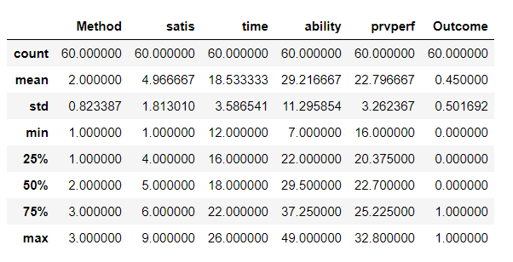
Basic Statistics
In the table, count represents the sample size of each categorical variable.
For those factors who’s mean and, the standard deviation is high they influence the “Outcome” to affect most as compares to a variable whose gap is little.
The value of Standard deviation is 0.50 which is a low standard deviation indicates that most of the numbers are close to the mean 0.45.

Slide 7
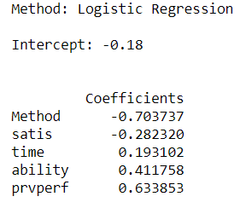
Logistic Regression
Outcome = - 0.18 - 0.70*(Method) - 0.28*(Satis) + 0.19*(time) + 0.41*(ability) + 0.63*(prvperf)
In this model, each number is treated as a weight and the sign (+ or -) is the average effect on “Outcome”.
The coefficient of “prvperf” is 0.63 states that the increase in the student’s score on a standardized math test a year ago should increase the outcome value.
On the other hand, the coefficient of “Method” is -0.70 which means a method of instruction reduced the outcome if we follow the same method of instruction.
Cont..

Slide 8
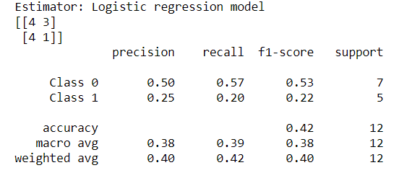
The figure reveals the confusion matrix of Logistic Regression in which precision determines how accurate our model is when it is closer to 100%.
This model clarifies the division of the fluctuation between the quantities anticipated by the model and the value as opposed to the mean of the actual. This value is between 0 and 1.
This model predicts a better negative variation in prvscore because f1-score for class 0 is 0.53 but class 0 has very little f1-score 0.22, therefore it is difficult to determine the positive change in prvscore.

Slide 9
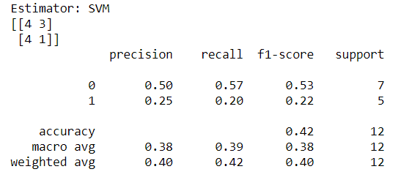
Support Vector Machines
To evaluate an algorithm, we used a confusion matrix, precision, and recall. Moreover, confusion matrix and classification methods are used to find the scores.
The accuracy of this model is 0.42 which demonstrates that the SVM model is not good to predict the outcome.
This model does not good to predict a positive variation in prvscore because f1-score for class 1 is 0.22 but class 1 has better f1-score 0.53, therefore this SVM model is good to determine the negative change in prvscore.

Slide 10
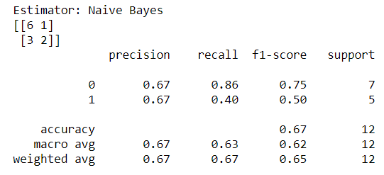
Naïve Bayes
Naive Bayes classifier performs better compared to other models and it needs less training data.
The model is correctly classified by the confusion matrix as its true negative value 6 and true positive value 2.
The accuracy of this model is 0.67 which demonstrates that the Naïve Bayes model is good to predict positive and negative change in prvscore.
In this model, the probability of positive change of prvscore is 50% and the probability of negative change of prvscore is 75% from recall score.

Slide 11
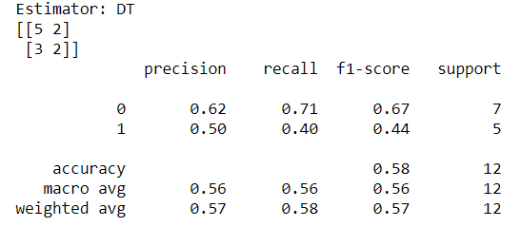
Decision Tree
This model shows the connection between “Outcome” and the independent variables. The value is between 0 and 1.
The half of the network incorrectly classified by the confusion matrix which demonstrates that the value of True positive is 5 and True Negative is 2 and the accuracy of 0.58 is not good to create model.
Recall describing the probability or positivity which determines that probability of negative change of prvscore and network does not define the value of positive change of prvscore based on f1-score of 0.44.

Slide 12
Insights and Findings
In the logistic regression, the value of accuracy, recall, f1-score is not good that implies our algorithm was not exceptionally good to make a sensibly great prediction.
In the Support Vector Machine, the half of the network incorrectly classified by the confusion matrix which demonstrates that the value of True positive is 4 and True Negative is 1 and the f1-score of 0.42 is not good to create model.
Naive Bayes classifier performs better compare to other models and it need less training data. The accuracy of this model is 0.67 which demonstrates that the Naïve Bayes model is good to predict positive and negative change in prvscore.
In Decision tree, if the precision “Outcome” would be 95% and the value of the total precision, recall and f1-score is more precious than it would be a specific model.

Slide 13
Recommendation
To improve the algorithm, we can add one more independent variable “Practice” which highly affects prvscore that increase the probability of “Outcome”.
John Hughes should add some variable to create high accuracy in the model and should train the x and y better which builds good model.
Multiple data can also help to correlate between the data and variables, more inputs would help to create high level model.
The accuracy of this model is 0.67 which demonstrates that the Naïve Bayes model is good to predict positive and negative change in prvscore.

Slide 14
Conclusion
The precision and recall of Naïve Bayes are greater than the other algorithm so for Mr. John Hughes Naïve Bayes is good model to conduct this analysis and to understand the positive and negative impact of prvscore on “outcome”.
NB algorithm is easy and fast to predict class of test data set and perform well in multi class prediction.
It perform well in case of categorical input variables compared to numerical variables.
Naive Bayes classifier performs better compare to other models and it need less training data.

Slide 15
Possible Improvements
SVM doesn’t perform well, when we have large data set because the required training time is higher.
In addition, precision level, recall, f1 score should be higher about 95% to get a more accurate decision tree model.
Naive Bayes model is easy to build and particularly useful for very large data sets. Along with simplicity, Naive Bayes is known to outperform even highly sophisticated classification methods.
Naive Bayes is easy and fast to predict class of test data set. It also perform well in multi class prediction.
When assumption of independence holds, a Naive Bayes classifier performs better compare to other models like logistic regression and we need less training data.

Slide 16


